Slide 1
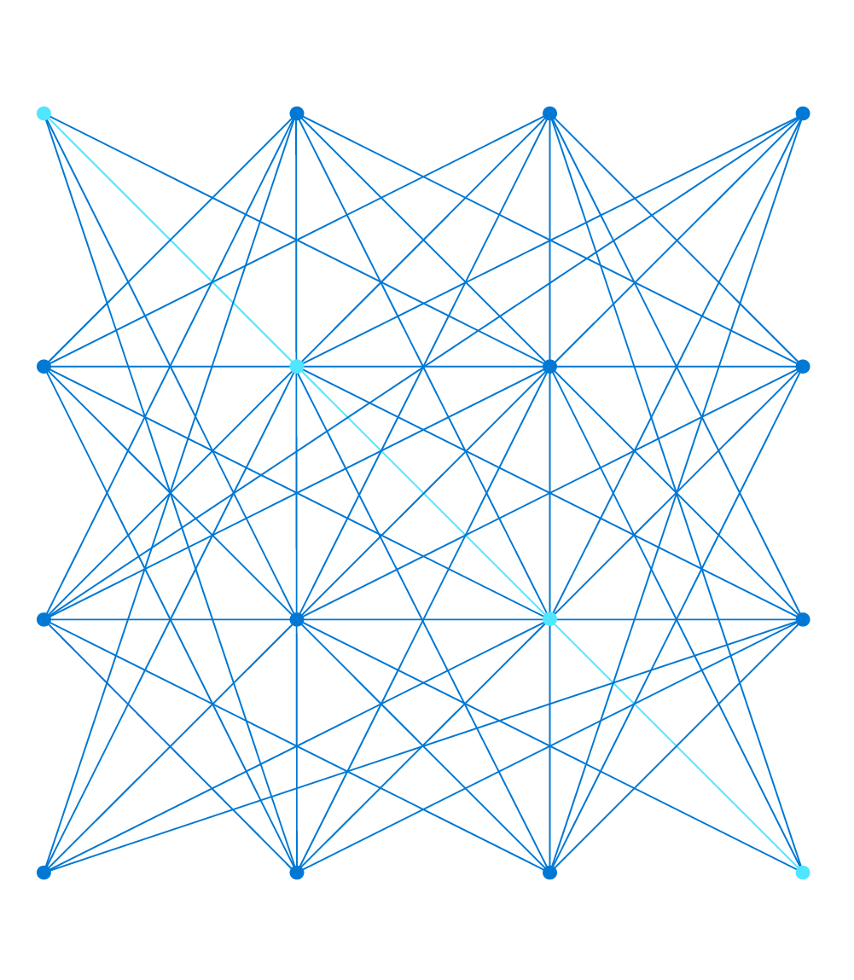
Azure IoT: State of IoT – Moving your business forward with Microsoft IoT
Notes:
Hi, I’m [name] and I'm a [title]
<Transition> Today, I want to dive into a bit about the trends, challenges and opportunities of IOT, as well as share a bit more about Azure IoT. Hopefully this can help you envision how you can power new possibilities in your own organization and achieve greater business impact.

Slide 2
Presenter guidance
The presenter should turn on the video function during presentation and turn off any audio notifications on their laptop
As the attendees are external – someone needs to let them in from the lobby (also during presentations)
We recommend attendees change their status to ‘attendee‘ to avoid someone from taking over the presentation
We recommend to have at least one proctor to let attendees in from the lobby and – more important – monitor the chat and answer questions there, so that the presenter doesn‘t have to do this job in parallel
For labs, we recommend having two proctors, one to monitor the chat (and to contact and chat with Spectra in case you need support), and a second to pick up attendees who aren‘t following at the same speed as others and do the labs with them in a break-out room in Teams in a slower pace
Inform the attendees that the morning presentations will be made available after the workshop
Let the attendees know they‘ll receive a link to a feedback form after the workshop and that their feedback is highly appreciated
IMPORTANT: Please count the number of attendees and send this number together with a screenshot of the meeting as POE after the event.

Slide 3
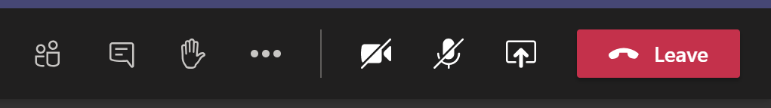
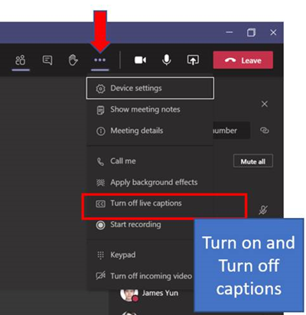
Please inform the attendees about Teams functions
Attendees should mute themselves (otherwise please do it yourself in the “attendee” section
Please inform in the beginning that they could always use the chat (that has to be monitored by you or your proctors – we recommend to have at least one proctor for chat communication only, so that the presenter does not have to do the job in parallel)
… or that they could leverage on the ‘Hand’ icon to catch the attention and the presenter will invite them to ask the question on the 2-way audio (attendee has to unmute himself for that)
For English subtitles, the attendees could use the option to turn on / turn off live captions

Slide 4
Why IoT

Slide 5


What is IoT?
Digital world
Insights
Things
Actions
Physical world
Notes:
The Internet of Things (IoT) is a set of technology (solutions) built on the connectivity of billions of devices, for consumers and enterprises of all sizes. IoT platforms offer command and control, unprecedented access to data, and continuous improvement through connected design.
IoT solutions focuses on 3 core components:
Things: This is the "T" in IoT. It means physical objects such as industrial equipment, devices, or sensors that connect to the Internet persistently or intermittently.
Insights: The connected devices collect vast amounts of information, which then gets analyzed and turned into actionable knowledge either by people or Artificial Intelligence (AI).
Actions: Taking the insight derived from data analysis, people make decisions and take action, connected to their business, as well as the systems and tools used.

Slide 6

What IoT is really about:
Deeper relationships
Customers
Employees
Employee input
Systems & experiences
Intelligent
More effective employees
More efficient ops
Customer signals
Product telemetry
Data & AI
Enabling a digital feedback loop
Operational data
Operations
Products
Better products
Notes:
Businesses want to evolve their operations, products, and how they interact with customers. By connecting devices and collecting data, it becomes possible to analyze that information to create new insights.
This lets companies make improvements to their business - from increasing operational efficiency to delivering better customer experiences and new revenue streams. A real-time connection enables new breakthrough levels of insight that in turn drive informed actions.
According to research by Keystone Strategy, leaders in digital transformation generate an average $100M more in operating income each year.

Slide 7










Where does IoT come from?
The evolution of IoT and connected solutions
Emerging
Connected Environments
Future
Connected ecosystems
Today
Connected Assets
Actions
Agility 40-50% faster speed to market
Productivity 20-30% higher workforce productivity
Stability up to 60% fewer IT errors and less rework
Performance 12-20% additional earnings before interest and taxes
Notes:
IoT devices come with an on/off switch for connectivity to the internet. This includes almost anything you can think of—cellphones, thermostats, doorbells, medical devices, or a biochip transponder in a farm animal. Data gets transferred over a network to a datacenter. This creates a gigantic network of internet connected 'things' and devices.
So, what exactly is the impact of getting data from all these things from the edge and putting them together? There are 4 major benefits:
Agility. In the cycle of development, when you speed up the processes and infrastructure, it means you can get your products and services to market more quickly. More than half the companies using IoT have seen such results.
Productivity. If you make real-time information available, you eliminate the delay of waiting that comes with collecting and analyzing information. That helps make people more productive.
Stability. IoT offers preventative maintenance through its insight. Such insight wasn't available before. Having this insight can help identify weaknesses in advance of their becoming serious issues.
Performance. The better the information used for analysis, the better decisions people make, which can lead to higher profits. Faster speed to market with products can also increase profitability.
[1] Source: https://www.zdnet.com/article/iot-to-drive-growth-in-connected-devices-through-2022-cisco/
[2] Source: Gartner
[3] Source: Deloitte
[4] Source: IDC FutureScape

Slide 8
State of IoT – IoT Signals report 2020

Slide 9

IoT Signals trends & opportunities
IoT adoption is key to business success
Challenges with PoC
Security remains top of mind consideration
COVID-19 is accelerating IoT strategies
Emerging technologies coming to the forefront
Notes:
The IoT Signals Report is an annual report Microsoft does to better serve their partners and customers, as well as help business leaders develop their own IoT strategies. It's meant to spotlight IoT adoption, challenges, trends, and opportunities.
The trends and opportunities seen this year were as follows:
IoT adoption has become a key to business success. 91% of businesses surveyed have adopted IoT in 2020, and 90% of decision-makers believe it is critical to their company’s continued success.
95% of adopters have experienced failure in PoC, with PoC failure often due to business challenges (70%) and scalability challenges (61%.) Support from leadership is a relatively low barrier during PoC; instead, leadership needs help integrating IoT into their long-term strategy. Ideally, that help should come from a single solution provider with a broad supplier network that can navigate the complexity of rolling out IoT at scale.
Though security challenges are low impediments to adoption, it remains a top-of-mind consideration. 97% of decision-makers have security concerns when implementing IoT, with data privacy as a top security concern for about half of all organizations. Apart from data privacy, ensuring network-level security and securing endpoints are critical, while security management is a lower priority.
COVID-19 is accelerating IoT strategies. 1-in-3 decision-makers state their organizations will increase their investment in IoT due to COVID-19, while another 41% say they’ll maintain the same level of commitment.
Finally, we have emerging technologies coming to the forefront. 79% of organizations adopt AI as part of their IoT solution, with 73% incorporating edge computing, and 73% implementing against a Digital Twins strategy.

Slide 10





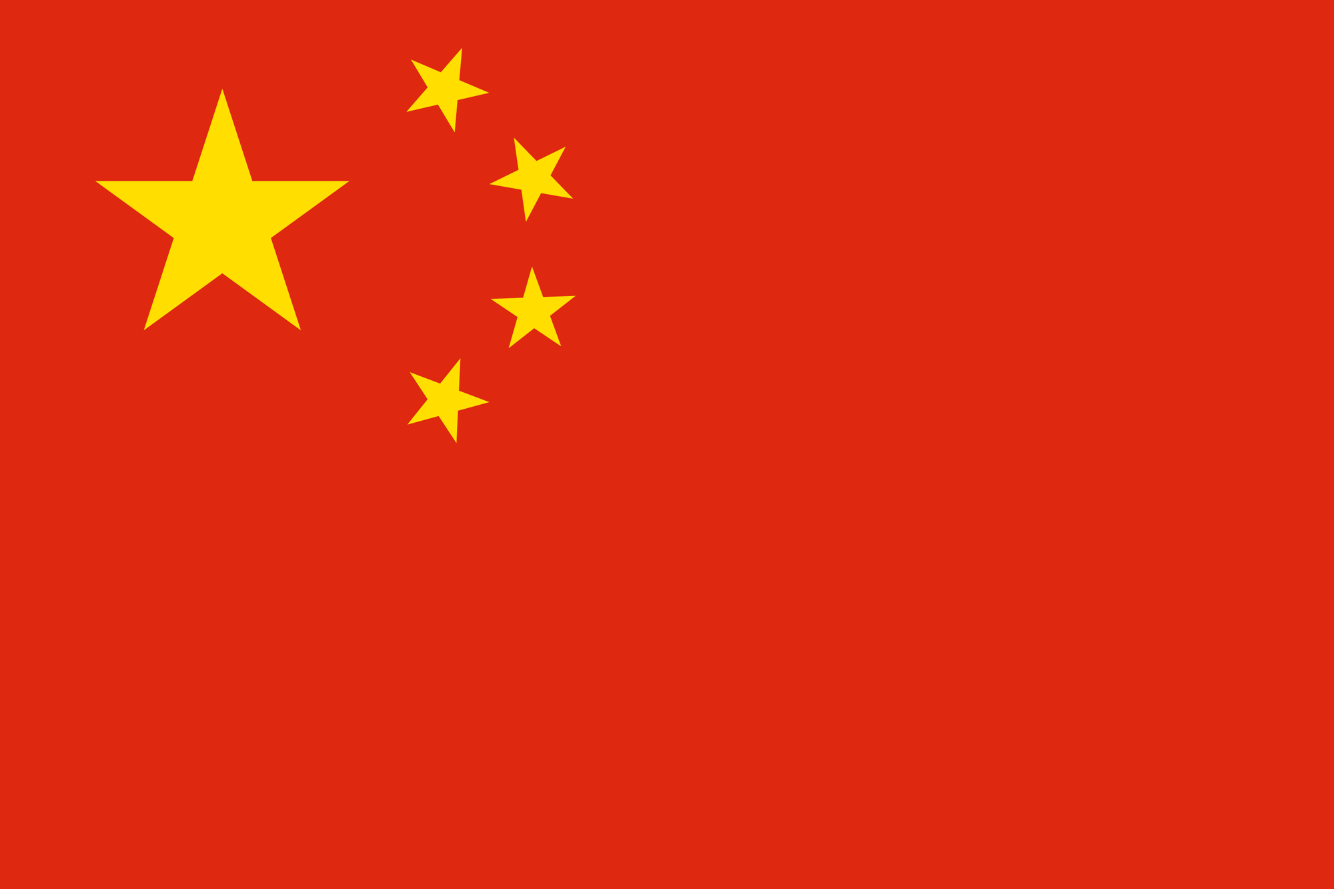
IoT adoption: A key to business success in 2020
Strong adoption rates around the world and across industries
 | Global
% IoT adopters* | 91%
Overall satisfaction** | 94%
90%
 | US | UK | DE | FR | JP | CH
% IoT adopters* | 92% | 88% | 94% | 92% | 87% | 91%
Overall satisfaction** | 97% | 95% | 97% | 99% | 75% | 98%
Of IoT adopters believe IoT is critical to overall success
 | Manufacturing | Retail | Healthcare | Energy
% IoT adopters* | 93% | 94% | 89% | 94%
Overall satisfaction** | 92% | 98% | 92% | 98%
Notes:
The report asks a series of questions pertaining to adoption, challenges, trends, and opportunities, as mentioned on the previous slide.
According to the results, IoT adoption, satisfaction, and value is strong around the world as is the satisfaction level. We’ve broken this slide down into user percentages and their satisfaction in certain categories.
First, we look at the adoption rate of some of the world’s largest countries. You can see both use and satisfaction are very high.
Within those countries, the study examined different industries, to see how they’re adopting and becoming more reliant on IoT. The four industries we chose to spotlight are Manufacturing, Retail, Healthcare, and Energy. As you can see, the results mirror closely those of the spotlighted countries, with Retail and Energy being the strongest in adoption and satisfaction level.
As a final note here, it’s worth mentioning that results of those surveyed showed us that 90% of IoT adopters believe IoT is critical to their overall success. This is the IoT value.

Slide 11
Top reasons for adopting IoT: Productivity and security
Reasons for IoT adoption
By industry
Safety and security (e.g. workplace safety, employee safety, IT security)
Operations optimization
Quality assurance (e.g. ensuring quality of product/staff processes)
Employee productivity
Manufacturing
Power & Utilities
47%
Plant safety and security | 36%
Worker safety | 25%
IT security | 40%
Employee safety | 30%
Workplace safety | 26%
47%
45%
Healthcare
Oil & Gas
IT security | 44%
Workplace safety | 39%
Employee safety | 37%
IT security | 41%
Employee safety | 31%
Workplace safety | 31%
43%
Top challenges to adoption
Retail
Surveillance and security | 40%
The complexity of scaling IoT and technical challenges still impede further adoption, even more than security challenges. Organizations need to undergo a culture change and prioritize investing in staff that can implement and maintain IoT solutions.
Notes:
So why do companies adopt IoT? What this study uncovered is that they’re adopting IoT as part of a broader culture change to optimize their productivity and secure their environment. Leading the way was safety and security as in workplace safety, employee safety, and so on. It tied with operational optimization, illustrating the expectations of organizations by digitally transforming pieces of their infrastructure. Quality assurance, next on the list, refers to human resources and equipment. Employee productivity ranks fourth, and ties well with the top three in that if you provide a safe environment with quality assurance in place, your people will get more done and optimize operations.
You can also see we looked at the top 3 reasons for adoption in industries. In all instances, safety seemed to be the driving force. Security in some form, also was a leading factor.
Lastly, what challenges are companies encountering in adopting IoT to their environment. The main issue the report showed is the complexity of scaling IoT and technical challenges. These impede further adoption, even more than security challenges. Organizations need to undergo a culture change and prioritize investing in staff that can implement and maintain IoT solutions.

Slide 12
The challenges of Proof of Concept (PoC)
30% of IoT projects experience failure during Trial/PoC
70% business challenges are reason for PoC failure
61% scaling challenges are reason for PoC failure
Let us provide leadership for planning your PoC and long-term strategy with IoT.
Notes:
Sometimes, companies decide they want to adopt IoT but when they develop their proof of concept, it all falls apart. The study asked several questions pertaining to this topic. One thing it discovered was the issue isn’t buy-in from leadership as one might expect but really one of planning a long-term strategy with IoT.
Overall we see that 95% of those surveyed experienced some form of project failure during the trial stage. As to the types of challenges they encountered, the majority cited business and scalability as the main culprits.

Slide 13
The challenge to more IoT adoption
Still implementing current solution
Want to work out existing challenges
Don’t have budget
Don’t have human resources to implement & manage
Too complex to implement
33%
31%
Complexity & internal resourcing continue to be top issues
28%
As your trusted advisor, we’re here to help.
28%
27%
Notes:
On the previous slide we looked at what was stopping companies from adopting IoT. What we didn’t explore was companies that already have IoT in their infrastructure. What keeps them from adopting more.
Overall complexity & internal resourcing remain as top challenges, while security is a low barrier. You can see the top 5 here:
Still implementing current solution. Existing conditions played a role in several of these answers. Companies either have existing problems or started work on another solution, bumping IoT from the front of the line to the middle or back.
Want to work out existing challenges. Before taking on more, companies want to get a handle on smoothing out what they already have so that they can progressively forge ahead on a solid foundation as opposed to a shaky one.
Don’t have budget. This is hardly a surprise. Cost is almost always listed as a challenge with infrastructure change. Many companies flatline their IT budgets or lower them, making IT do more for less.
Don’t have human resources to implement & manage. When staff supply can’t meet demand, it usually comes down to cost and companies not having the budget to add staff.
Too complex to implement. Complexity causes many challenges, the greatest one perhaps being with highly customized solutions where adding or reconfiguring becomes a difficult process because of circumstances or the reality that few people understand the intricacies of their environment. This limits change to when these people have the time.

Slide 14
Security concerns during implementation remain a concern
TYPES OF IoT SECURITY CONSIDERATIONS
IoT security considerations
Types IoT security considerations
Ensuring data privacy
Ensuring network-level security
Security endpoints for each IoT device
Tracking and managing each IoT device
Conducting comprehensive training programs
47%
43%
97% have security concerns when implementing IoT
40%
38%
38%
Notes:
Another area the report asked about related to security and adoption. The survey provided a list of options to choose from in relation to IoT adoption. Security considerations were one of them. Based on affirmative answers, they went deeper into explaining their reasons why.
In general the results show that security is a universal consideration during IoT implementation, with data privacy top of mind for about half of all surveyed organizations.
These 5 security issues were the ones that companies responded to most:
Ensuring data privacy
Ensuring network-level security as in strong user authentications for network-level data
Having security endpoints for each IoT device
Tracking and managing each IoT device
Conducting comprehensive training programs for employees involved in the company’s IoT environment
But let’s be clear here, it is not all “doom-and-gloom” here. While IoT projects must be approached in a thoughtful and knowledgeable manner, there’s immense opportunity for businesses.

Slide 15
Increases efficiency of operations
Lets employees be more productive
Increases production capacity
Provides cost savings
Reduces human error
54%
47%
Many companies gain benefits after IoT adoption
46%
Increasing productivity and cost savings lead the way
44%
44%
Notes:
Here we see what types of benefits IoT adopters were seeing. Increasing productivity, specifically efficiency and yield, carries through as a top benefit.
Here’s the top 5:
Increases efficiency of operations
Lets employees be more productive
Improves production capacity
Provides cost savings
Reduces human error
These results are consistent with 2019 by the way.

Slide 16
Most common measures of success
Cost efficiency
Quality
Production efficiency
Reliability
Security
How companies are measuring their IoT success
Using cost, reliability, and security as key performance indicators
Least common measures of success
More informed decision-making
Direct impact on increased revenue
Sustainability
% of projects deployed using IoT
Notes:
An interesting question for IoT adopters isn’t just the benefits or success stories, it’s about what systems they’re using to measure the success of IoT in their environment?
The most common measures of success were as follows
Cost efficiency (e.g. % reduction in operating costs)
Quality. (e.g. % decrease in human error)
Production efficiency. (e.g. % increase in production)
Reliability. (e.g. % increase in equipment optimization)
Security. (e.g. % decrease in malware attacks)
There aren’t any surprises here. These are often common measures. Now let's look at the least common measures of success:
The least common measures of success
More informed decision-making. (e.g. accelerate timelines)
Direct impact on increased revenue. (e.g. add new product innovations)
Sustainability. (e.g. % decrease in emissions)
% of projects deployed. (e.g. use IoT)
A couple of interesting takeaways. Companies use the money they save as a measure but not the revenue they earn. Similarly they look at production efficiency more so than the productivity in terms of projects being deployed.

Slide 17
Moderately successful
Very successful
Cost efficiency
Quality
Production efficiency
Reliability
Security*
50%
43%
Where companies are finding the most success with IoT
43%
52%
47%
48%
Security, informed decision-making, and sustainability efforts
44%
52%
39%
59%
Notes:
Using the model created from the last slide, we can see the level of success with each of the pillars we previously described.
For cost efficiency, notice that it’s the only pillar of the five in which moderately successful outnumbers very successful.
And for security, as you can see, it scored the highest in the ‘very successful’ tier and had the widest gap between very and moderately successful, showing the slant towards the high level of success.

Slide 18
No plans
Less
Same
Looking ahead
Two years from now, we will be using IoT…
IoT adoption will not slow down anytime soon
2-in-3 organizations anticipate using
IoT even more than they do today
More than we currently are
Notes:
The report also made some forward-looking projections. To that end, it included a question about looking two years into the future, asking if the responder thought they’d be using more or less IoT as compared to now?
As you can see from the results, approximately two-thirds said they expected to use more and a mere 3% thought they’d be using less.

Slide 19
Microsoft IoT

Slide 20
Azure IoT helps you transform your business
Quickly turn your vision into reality with secure, scalable, and open, edge-to-cloud IoT solutions
Develop with choice
Prepare for future innovation
Secure data everywhere
Power the Edge
Scale globally
Notes:
Azure IoT is a collection of Microsoft-managed cloud services that connect, monitor, and control billions of IoT assets. With it you can quickly turn your vision for a connected future into reality with secure, scalable, and complete, edge-to-cloud IoT solutions. We’ve broken down the platform into five primary pillars:
Develop with choice
Simple tools, simple templates, and simple open source. You can build open and flexible IoT solutions on your terms. Get leading device management, cloud integration and choice across fully managed applications or IoT platform services.
Prepare for future innovation
Innovation is a journey without end. You can build on a platform and with an ecosystem with a bold commitment to sustainability and continuously enhanced data, AI, and analytics solutions. Integrate into your existing systems, launch into new opportunities. There’s so much potential here.
Secure data everywhere
With Azure IoT, you can trust your data estate is secured from endpoints to the cloud. That’s because we partner with the most proactive leader in IoT security with the largest portfolio of regulatory and compliance certifications in the industry.
Power the Edge
Azure IoT lets you move your AI and business workloads to the edge. This lets you react with more agility, operate more reliably, and spend less time transmitting to the cloud.
Scale globally
Scalability is always an important issue. With Azure IoT, you can unlock the largest IoT ecosystem global to scale, wherever and whenever you are ready to grow.
Microsoft dedicated to improving every facet of IoT for business, which is why it’s investing $5 billion to do just that.

Slide 21
Develop with choice
Prepare for future innovation
Secure data everywhere
Power the Edge
Scale globally
Azure IoT Central
Azure IoT Hub
Digital Twins
Notes:
Let’s look deeper at the platform. We start with develop with choice.

Slide 22



Develop with choice
Digital Twins
Azure IoT Central
Azure IoT Hub
The easiest and most cost-effective way to connect and manage devices at scale, and time to results.
Enable highly secure, flexible and reliable communication from the cloud to the edge.
Create comprehensive digital models of entire environments.³
1000+ Azure IoT Devices certified¹
150 billion messages per month via IoT Hub²
Gartner includes Microsoft as a Digital-Twin-Enabled Application Provider³
1 Placeholder Source; 2 Placeholder Source; 3 Gartner: Market Guide for Digital Twin Portfolios and Enabling Technologies (Jan 2020)
Notes:
Azure IoT Central is the easiest and most cost-effective way to connect and manage devices at scale. It connects your IoT devices to the cloud faster than any other platform. You can find new devices matched to your solution in the Azure Certified for IoT device catalog. Also, we understand how hard it is to keep devices connected and healthy. Azure IoT Central lets you reconfigure and update devices with centralized device management. In addition, the connectors and extensibility APIs bridge the gap between your business applications and IoT—a direct connection between IoT data and your decision makers.
Azure IoT Hub is a Platform as a Service. With it you can do the following:
Establish bi-directional communication with billions of IoT devices
Enhance security with per device authentication
Provision devices at scale with IoT Hub Device Provisioning Service
Manage devices at scale with device management
Use multi-language and open source SDKs
A Digital Twin (DT) is a dynamic digital representation of a physical piece of equipment, or thing, and its associated environment. Every DT has a dynamic data model containing only a few, or even thousands, of data attributes of the physical thing or system it represents. Attributes are associated with sensors that are measuring temperature, pressure, and other variables and associated physics in order to represent real-world operating conditions as well as static values like the installation date or OEM. Azure Digital Twins is the development platform for next-generation IoT solutions that model the real world.
<click>
Our lab later today will focus on using the Azure IoT Hub platform.

Slide 23
Prepare for future innovation
Develop with choice
Secure data everywhere
Power the Edge
Scale globally
Azure Time Series Insights
Notes:
Next, lets talk about preparing for future innovation.

Slide 24
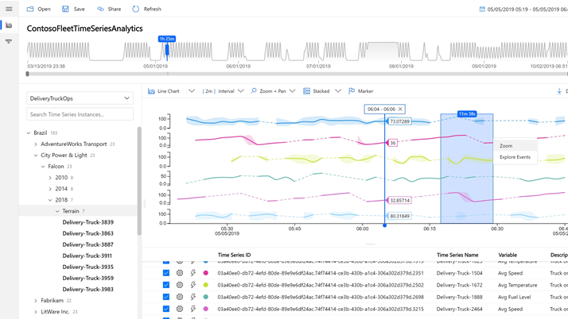

Azure Time Series Insights (TSI)
A serverless, fully-managed Platform as a Service (PaaS) solution built for IoT
Ingest, process, store, and query highly contextualized, time-series-optimized, IoT-scale data
Built-in rich user experience for ad-hoc queries and exploration
Rich analytics APIs for ad-hoc exploration and operational intelligence
JavaScript control library for building custom analytics apps on the TSI platform
Notes:
Azure Time Series Insights (TSI) is a serverless, fully-managed Platform as a Service (PaaS) solution built for IoT. Features include the following:
Highly contextualized, time-series-optimized, IoT-scale data that can be Ingested, processed, stored, and queryed
Built-in rich User Experience for ad-hoc queries and exploration
Rich analytics APIs for ad-hoc exploration and operational intelligence
A JavaScript control library for building custom analytics apps on the TSI platform

Slide 25
Secure data everywhere
Develop with choice
Prepare for future innovation
Power the Edge
Scale globally
Azure Sentinel
Azure Defender for IoT
Azure Sphere
Notes:
Next, we have security.

Slide 26

Azure IoT security
End-to-end threat protection for IoT solutions
Azure Defender for IoT
Azure Sentinel
Azure Sphere
Azure Sphere Guardian
Azure IoT Central
Azure IoT Edge
Azure IoT Hub
Notes:
Azure offers IoT security with options for end-to-end protection for your IoT solution. Microsoft’s integrated hardware, software, and cloud services work seamlessly together and deliver active security by default.
Here are different components of Azure’s comprehensive security features:
Azure Defender for IoT
Protects unmanaged IoT/OT devices with agentless asset discovery, vulnerability management, and threat detection
Azure Sentinel
Provides intelligent security analytics for your entire enterprise with the industry’s first cloud-native SIEM/SOAR
Azure Sphere
Offers a comprehensive IoT security solution—including hardware, OS, and cloud components
Azure Sphere Guardian
Increases brownfield security posture paired with existing equipment to enable secured connectivity
Azure IoT Central
Reduces risk by using security posture management, threat monitoring, and remediation
Azure IoT Edge
Ensures devices have the right software and that only authorized edge devices can communicate with one another
Azure IoT Hub
Enables highly secure and reliable communication between your IoT application and the devices it manages

Slide 27
Azure Sphere
An end-to-end solution for securely connecting existing equipment and creating new IoT devices with built-in security
Azure Sphere operating system
Azure Sphere certified chips
Azure Sphere operating system (OS)
Azure Sphere security service
Ongoing OS and security updates
Azure Sphere certified chips
Ongoing support
Azure Sphere security service
Notes:
Azure Sphere brings more than 10 years of security and OS updates delivered directly to each device by Microsoft. It’s an end-to-end solution for securing IoT devices. You can use it to secure your existing mission-critical equipment, or to build net-new devices that are secured from the start. So device manufacturers can focus their energy on the applications and features they want to deliver to customers, and not the rigorous work it takes to manage a secured operating system.
Features include:
Security support for any device
Ongoing OS and security updates
Edge workloads protected by enclaves
Threat monitoring and mitigation across devices

Slide 28
Power the Edge
Develop with choice
Prepare for future innovation
Secure data everywhere
Scale globally
Azure IoT Edge
Notes:
Power to the edge includes different components of Azure IoT Edge.

Slide 29

IoT Edge
Run Azure AI, Azure Services and Custom Services directly on IoT devices
Offload AI and analytics workloads to the edge
Operate offline or with intermittent connectivity
Respond in real-time since analytics happen at the edge
Open source, cross platform, container-based edge runtime
Simplify development using language skills you already have
Notes:
Azure IoT Edge lets you extend cloud intelligence to devices. It addresses the risks that are inherent when moving data and analytics to the edge, with security standards that balance flexibility for different deployment scenarios with the protection that one might expect from all Azure services. Azure IoT Edge runs on various makes and models of hardware, supports several operating systems, and applies to diverse deployment scenarios. And it’s an extensible security framework based on well-grounded principles that are designed for scale.
Azure IoT Edge modules are units of execution, implemented as Docker compatible containers, that run your business logic at the edge.
Azure IoT Edge runtime enables custom and cloud logic on IoT Edge devices.
Azure IoT Edge cloud interface enables remote monitoring and management.

Slide 30
Scale globally
Develop with choice
Prepare for future innovation
Secure data everywhere
Power the Edge
Partner network
Azure Marketplace
Datacenters
Notes:
Lastly, we have scale globally.

Slide 31

Microsoft’s comprehensive IoT product portfolio
Azure IoT priority verticals
Manufacturing
Retail
Agriculture
Energy
Smart Places
Healthcare
Transportation
Azure IoT Central
Dynamics Connected Field Service and Connected Store
Azure IoT solutions
Azure Security
Center for IoT
Azure IoT Hub
Azure IoT Hub Device Provisioning Service
Azure Digital Twins
Azure Time Series Insights
Azure Maps
Azure Stream Analytics
Azure Cosmos DB
Azure AI
Azure Cognitive Services
Azure ML
Azure Logic Apps
Azure Active Directory
Azure Monitor
Azure DevOps
Power BI
Azure Data Share
Azure Spatial Anchors
Azure
Services for IoT
Azure RTOS
Azure Sphere
Azure IoT Device SDK
Azure IoT Edge
Azure Stack Edge
Windows IoT
Azure Certified for IoT—Device Catalog
Azure Stream Analytics
Azure Storage
Azure ML
Azure SQL
Azure Functions
Azure Cognitive Services
IoT & Edge
device support
Notes:
Microsoft has the industry-leading portfolio of services that help customers easily create IoT solutions spanning the intelligent cloud and edge based on their needs—from ready to use Software as a Service (SaaS) applications to custom solutions across device, cloud, and integration services.
Azure IoT is helping our customers make things happen at every level of their organization’s digital transformation by providing the most comprehensive portfolio for IoT from the edge to the cloud. You get enterprise-ready solutions, predictable costs and timelines, and the largest network of IoT partners across industry. You not only put your organization in position for evolution with improved efficiency and improved margins, but with advanced analytics and AI, Azure IoT puts your organization in position for revolution to disrupt, create new revenue streams, and stay ahead of the pack.

Slide 32




























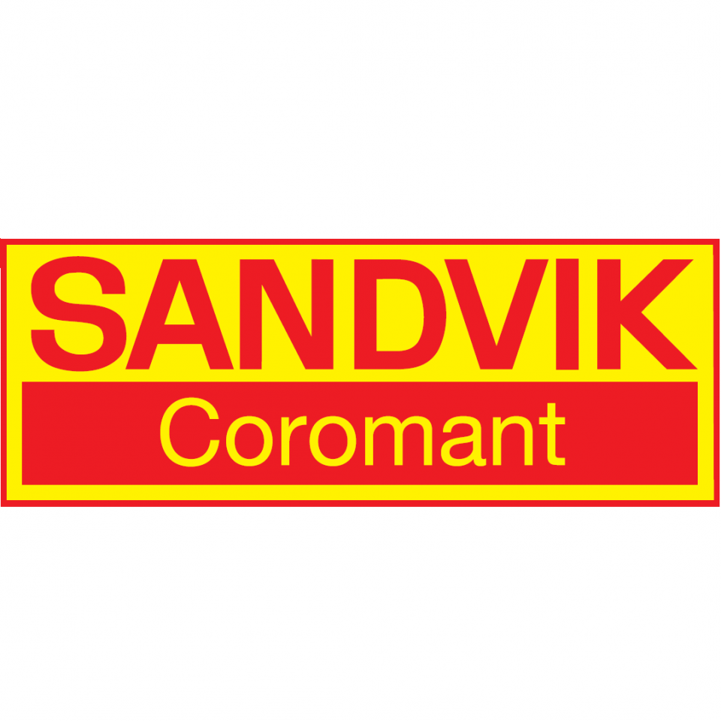









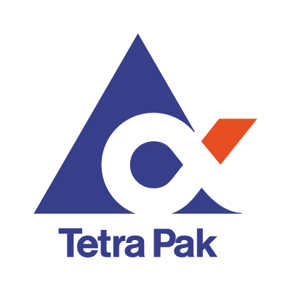







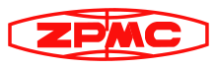




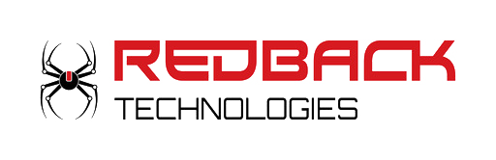






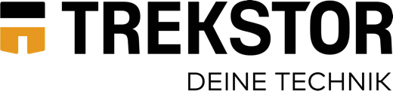


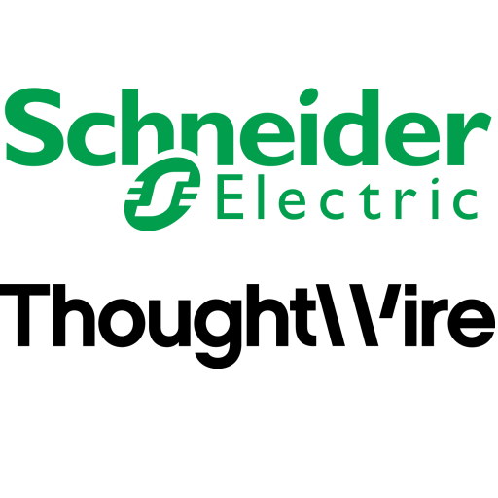
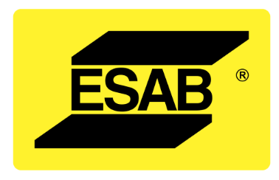
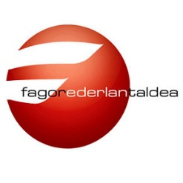
















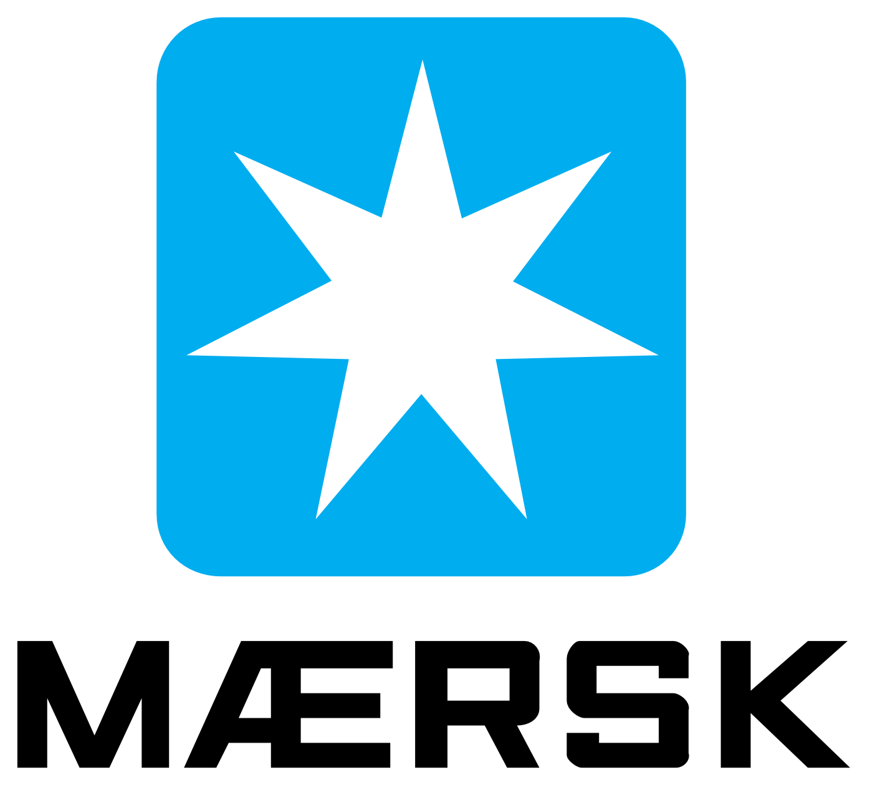
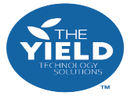











Customer momentum

Slide 33
Resources
Business Model Workshop Learn how to develop profitable, sustainable and scalable business models in a variety of partnership and commercial scenarios.
Architecting Design Session Take a deep dive into the process for architecting the intelligent edge.
Developer Cert Learn about the developer certification path and popular options.
IoT Signal Reports 2020 Read an annual report designed to help business leaders develop their own IoT strategies.
8 properties of an IoT solution white paper Learn how to reduce the risk of failure with this detailed look at key IoT properties and how to put your IoT solution on a path to success.

Slide 34
Thank you.

